Slide 1
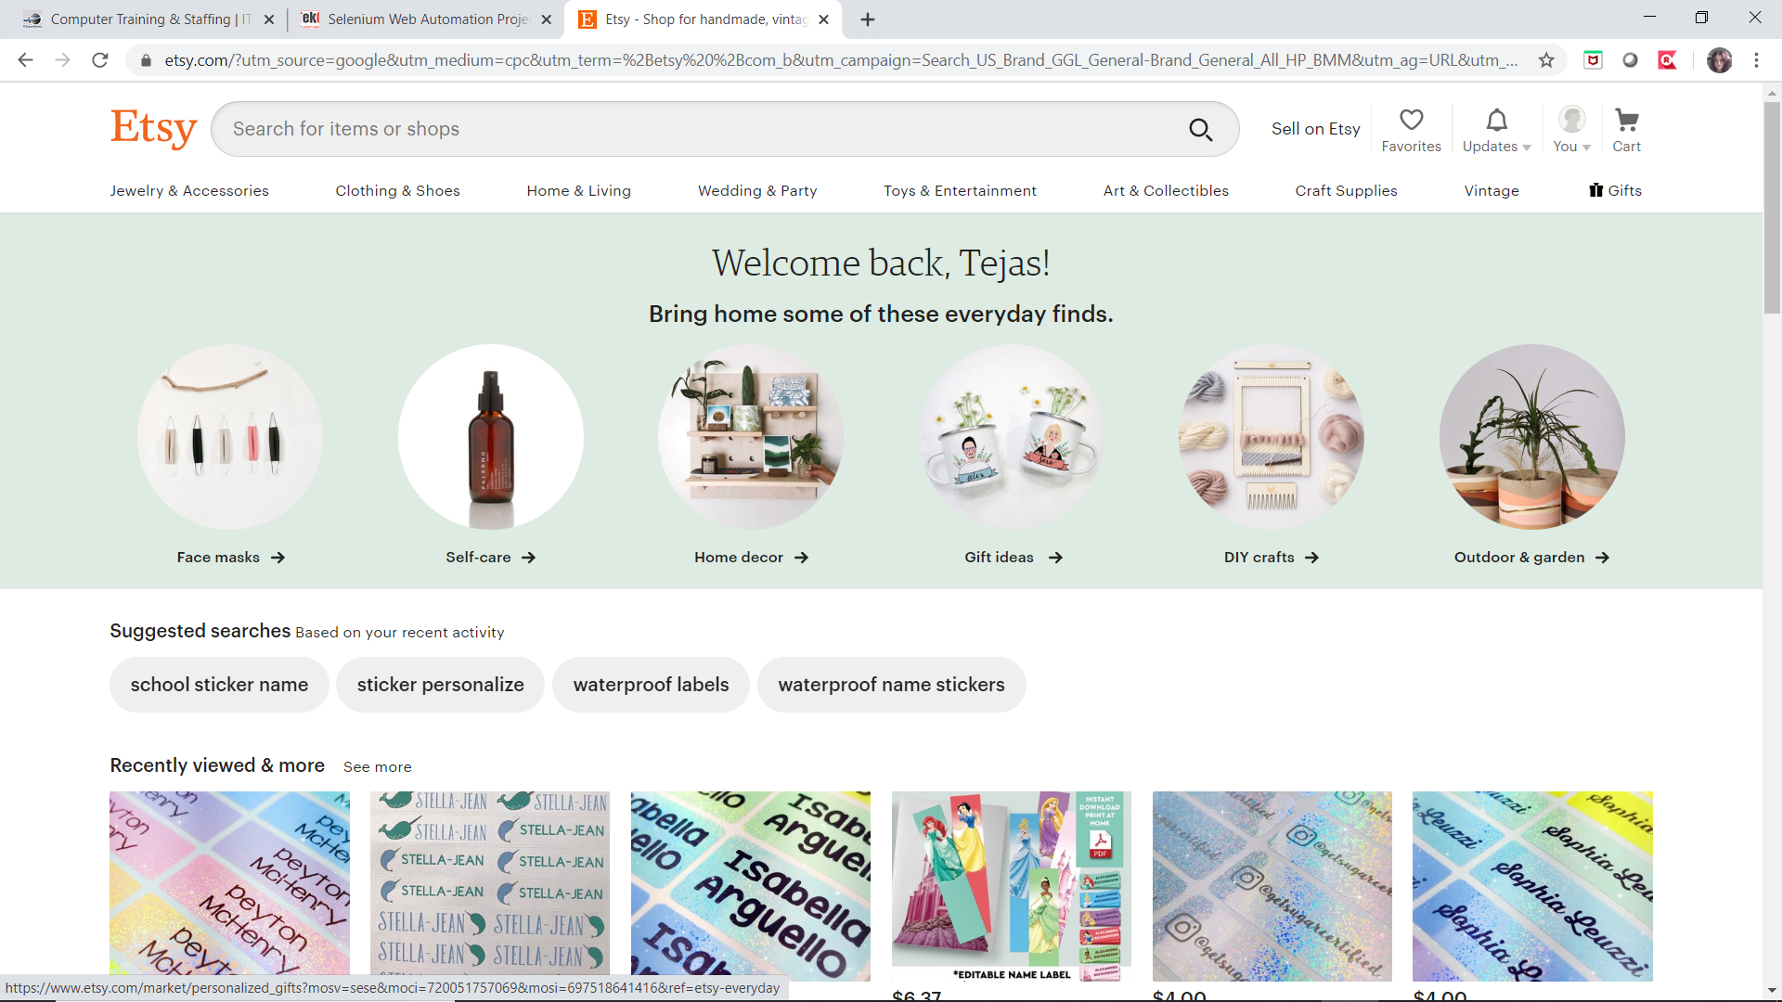
About Etsy.com
Etsy is the global marketplace for unique and creative goods. It’s home to a universe of special, extraordinary items, from unique handcrafted pieces to vintage treasures.

Slide 2
Etsy.
Etsy is an American e-commerce website focused on handmade or vintage items and craft supplies. These items a wide range of categories, including jewelry, bags , clothing, home décor and furniture, toys, art, as well as craft supplies and tools.
Selling
Creating a shop on Etsy is free; however, each listing that is posted in the shop costs $0.20. Each listing will remain on the shop's page for a maximum of 4 months, or until someone buys the product. The prices of products are set by the shop owner, but Etsy claims 5% of the final sale price of each listing. Shop owners are sent a bill at the end of every month detailing the fees Etsy has charged them, and they have until the 15th of the following month to pay the fees. Sellers can choose which payment options to offer buyers, including credit cards, debit cards, and PayPal, among others.

Slide 3
Etsy.
Buying
On the Etsy homepage, potential buyers can type a "product description" into the search bar, or, alternatively, they can "browse" through a list of options on the left side of the homepage, which includes Art, Home & Living, Jewelry, Women, Men, Kids, Vintage, Weddings, Craft Supplies, Trending Items, Gift Ideas, Mobile Accessories, and more. Furthermore, buyers may choose from a list of categories by clicking on the "categories" link under "More Ways to Shop". This will bring the user to a page of over 30 categories, each containing subcategories.
When a buyer views a product, they can choose to view the positive percentage feedback of each seller to determine the reliability of the shop. Once a buyer finds a product they would like to buy, they click "Add to Cart", and that product is added to their virtual "Shopping Cart". The buyer may then either continue shopping or purchase the selected item. In order to purchase items, buyers do not have to have an account with Etsy and can instead register with a Facebook or Google account.
Etsy has received criticism for its handling of customer data and privacy. as of 2016, according to the "Privacy Policy" section on the website: "By using Etsy, you authorize Etsy to use your information in the United States, Ireland and any other country where Etsy operates ".

Slide 4

Agile Cross-Functional Team.
Tejas – Test Lead
Sumeet – Tester
Oksana – Tester
Yevgen - Tester

Slide 5
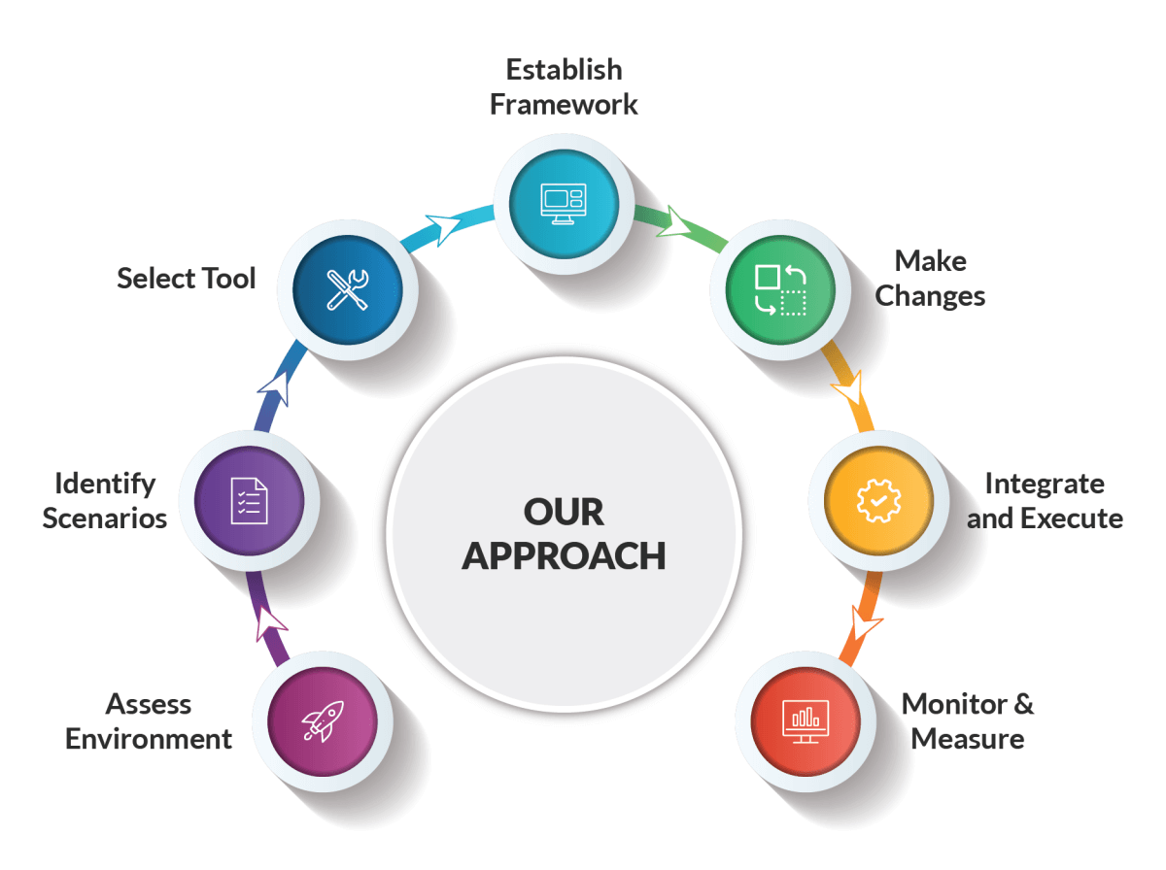

Slide 6

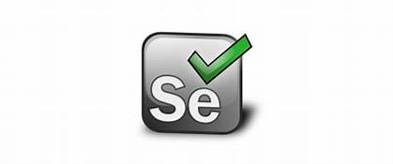

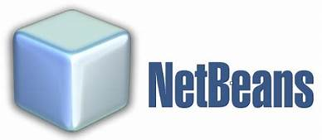





Technology we used in our project.

Slide 7
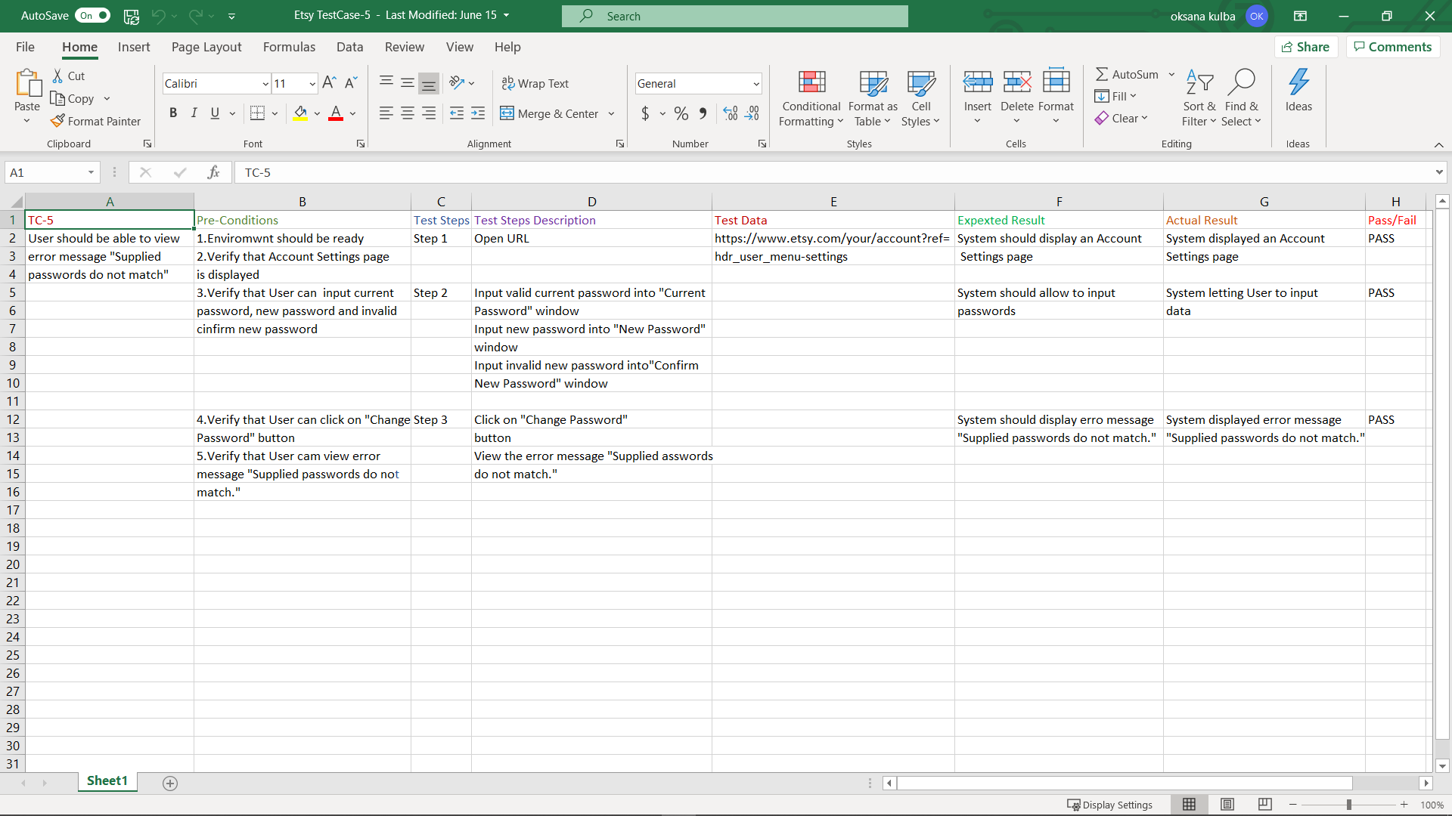
Test case in Excel sheet.

Slide 8
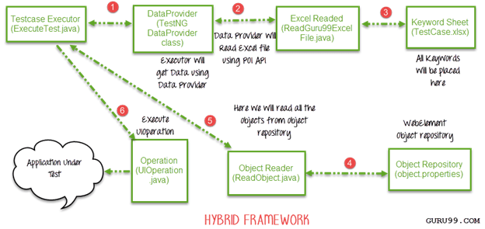
Application Architecture.

Slide 9
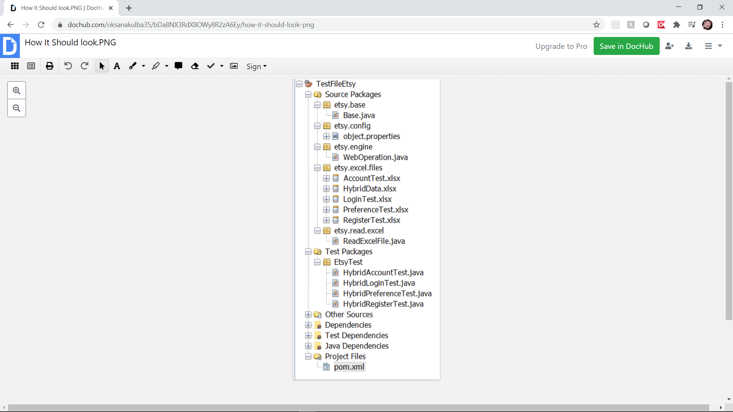
Etsy project structure.

Slide 10
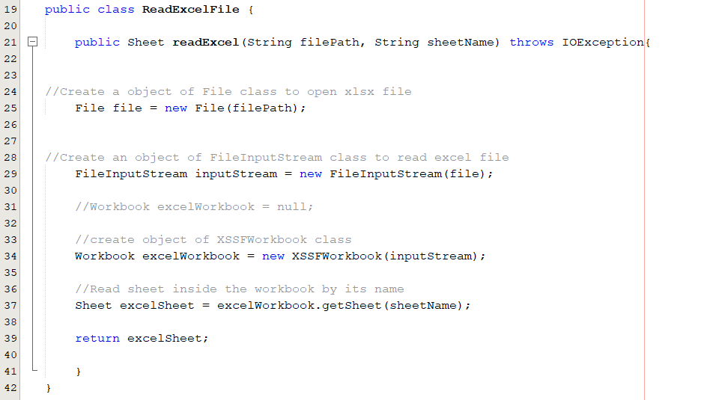
Notes:
Now Lets See how the framework runs
Now first we create a java class that allow us to read excel file base on the two inputs
Click: File Path
Click: SheetName

Slide 11
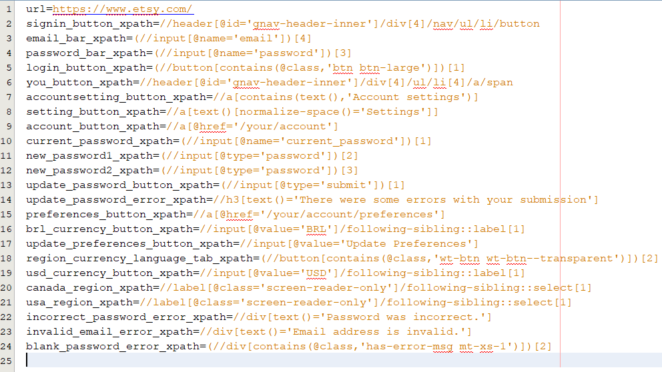
Notes:
Now That we have created the java class that reads excel files we can jo to our next step
The next Thing we do is create Object repository file.
This file might not look important but is very useful for code management.
for example lets say that the developer changes the ID for the sign in button. since sign in button is used in most of the test you will have to change ID path for each of the test case but if object repository is used we will have to change the ID only once in the object repository and everything else can remain the same.

Slide 12
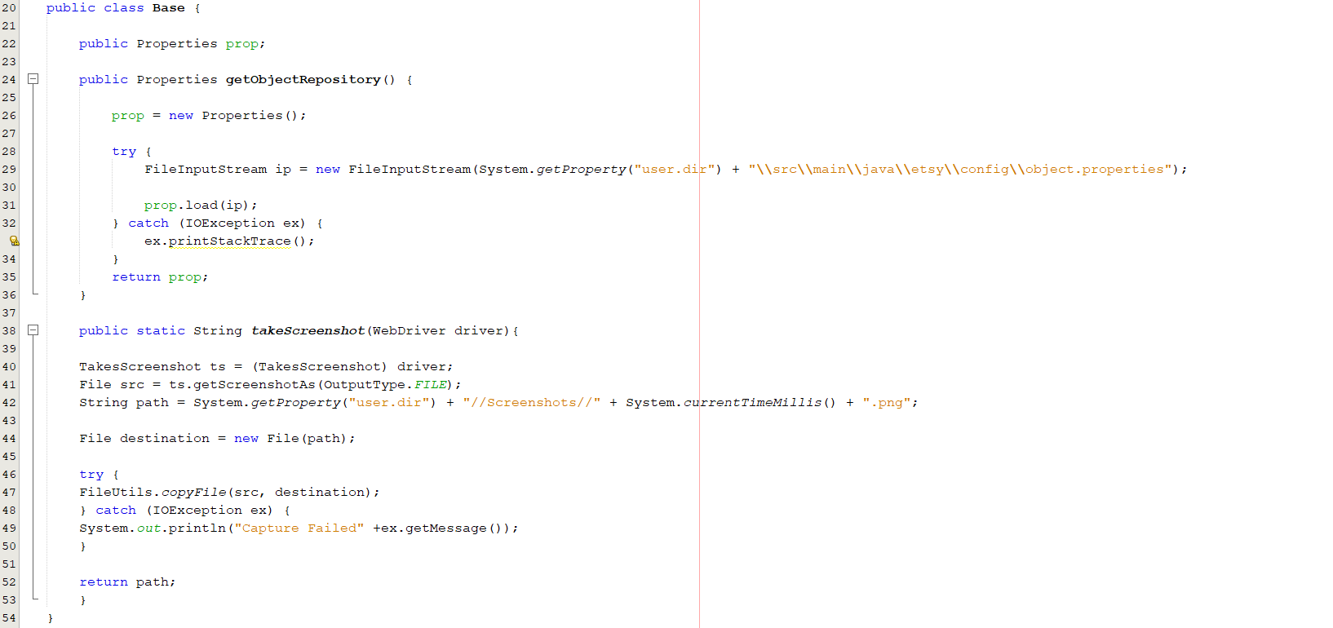
Notes:
Now That we have created object repository we have to create a way to read the file. we can achieve this goal by writing the getObjectRepsitory function mentioned here.
The other code below is used to take screenshot that we will be using for report generation.

Slide 13
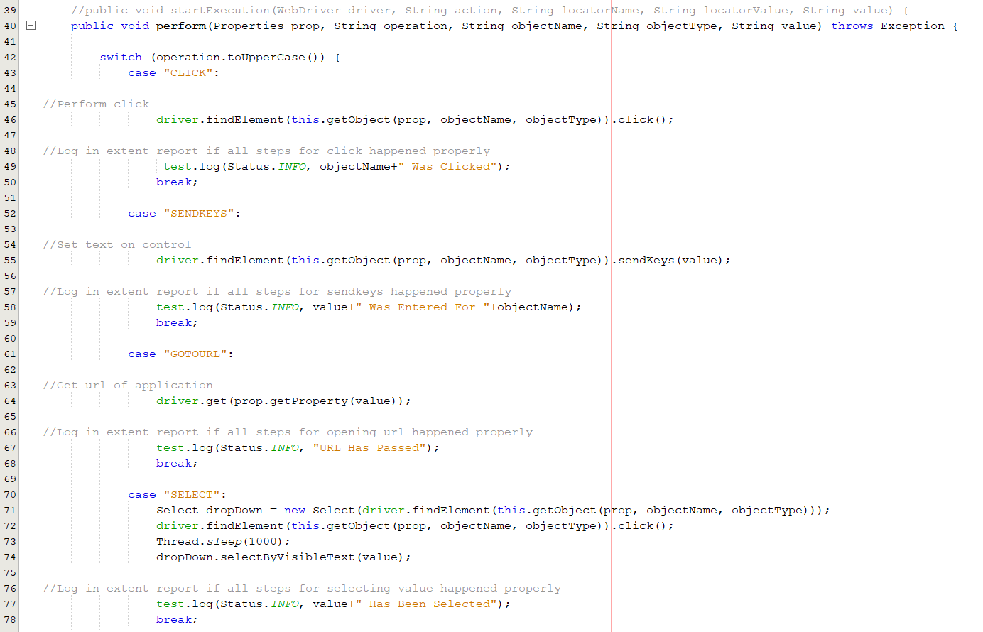
Notes:
Now Lets talk about the most important java class.
this class contains 2 function
first one is perform. it takes 5 inputs
Click: 1st input allow us to read object repository
Click: 2nd input provides us the key word from the excel sheet
Click: 3rd input gives us the objectname from excel file
Click: 4th input give us the objecttype from excel file (ie xpath, ID, Name etc)
Click: 5th input gives us the value that we will be using to get the desired output
Click: now we use switch function to compare the keywords and base on the keyword provided respective code will be performed
For example lets assume the the key word is sendkeys
Click: the program will go to this line with will send it to our second part of our weboperator which is getObject function with takes 3 inputs.

Slide 14
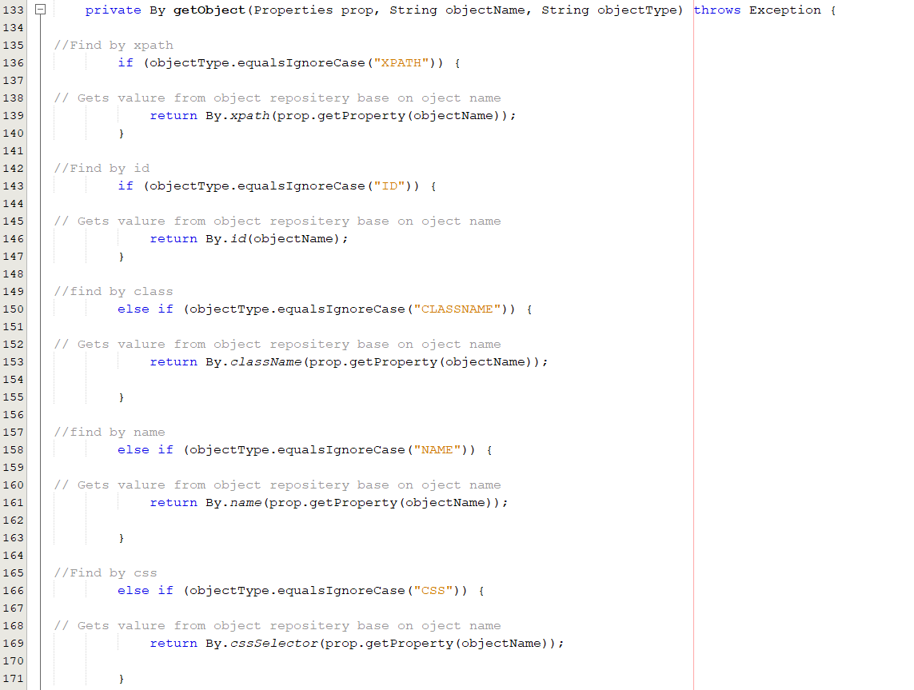
Notes:
now using the 3 input provided we will use the object type to decide which function we will be using.
So for example lets say user provided object name as xpath
click: the program will go to the if condition that is satisfied for xpath. from here it will compare the objectname between excel sheet and object repository and object repository will return the respective xpath
then the properties from getobject will be returned to the first part of our weboperator

Slide 15
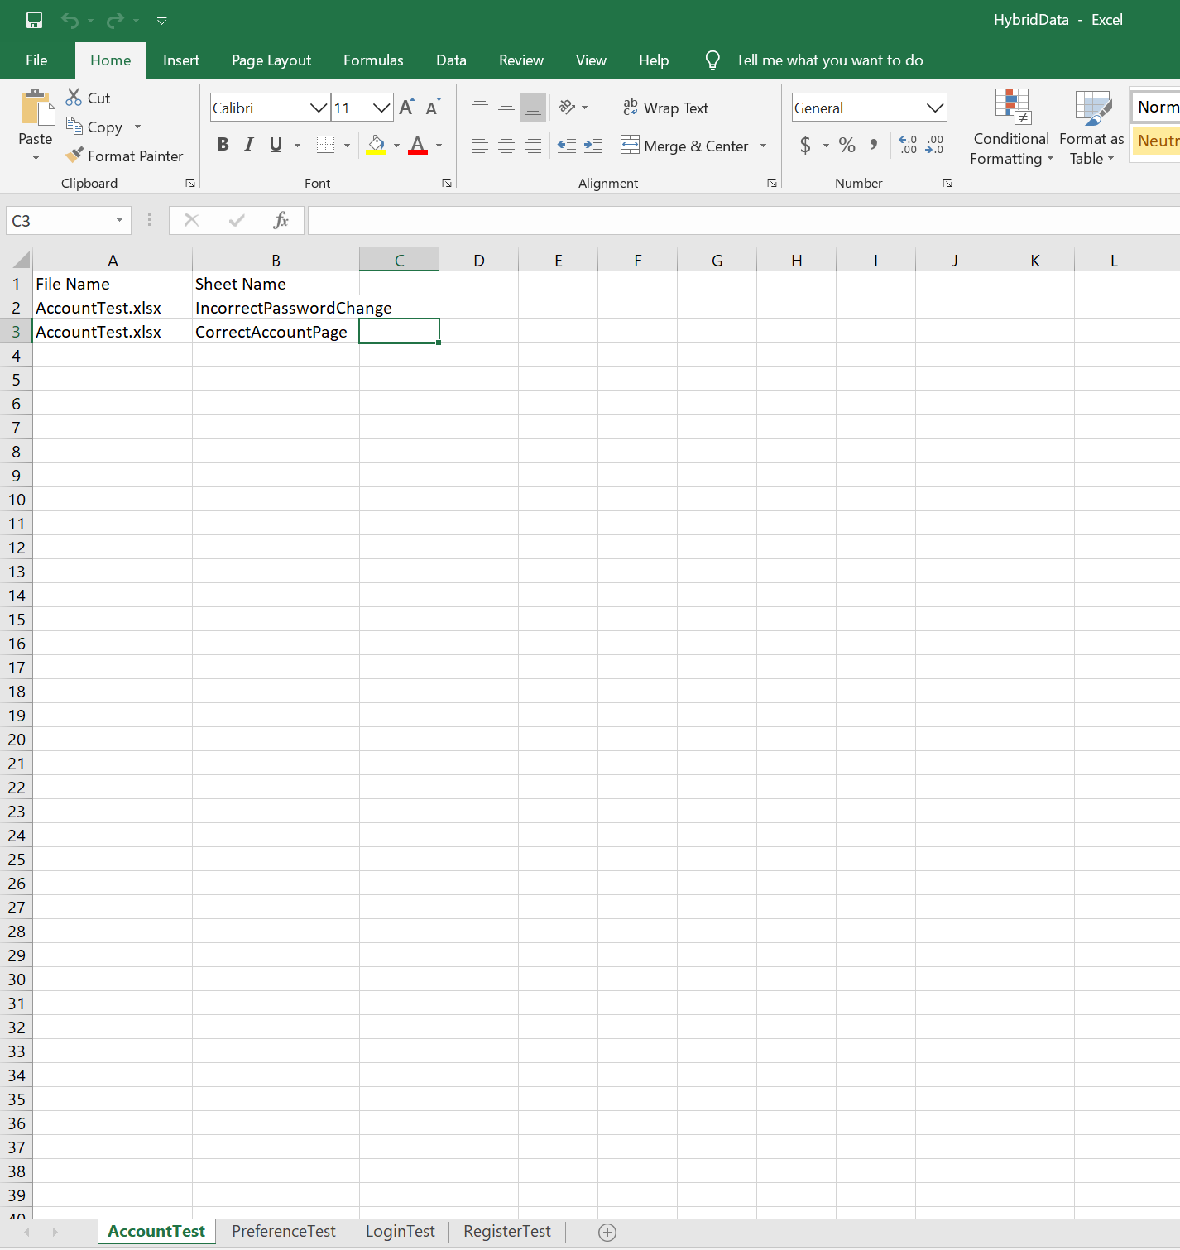
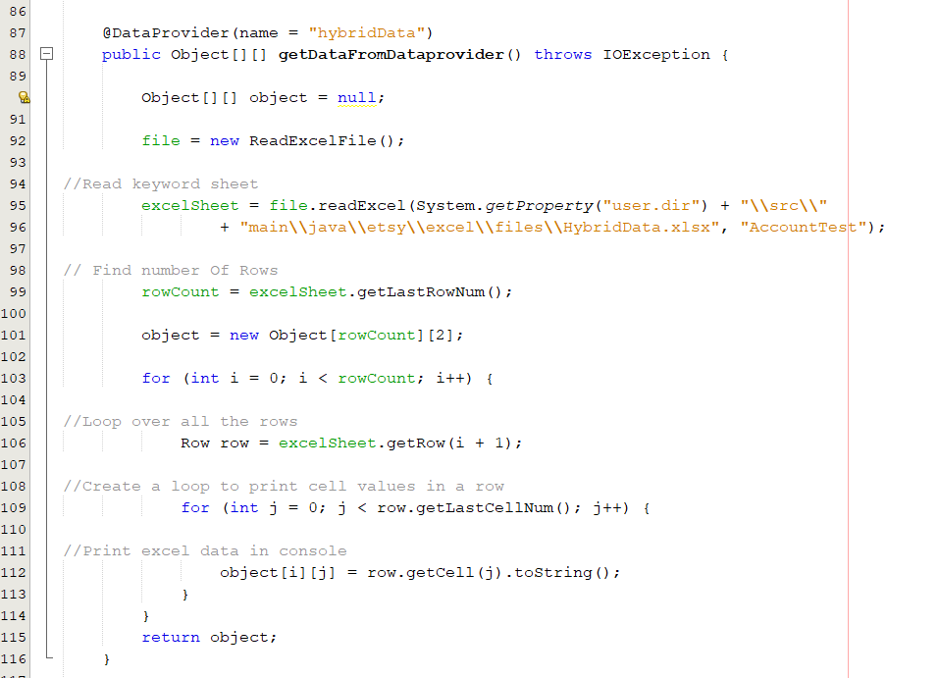
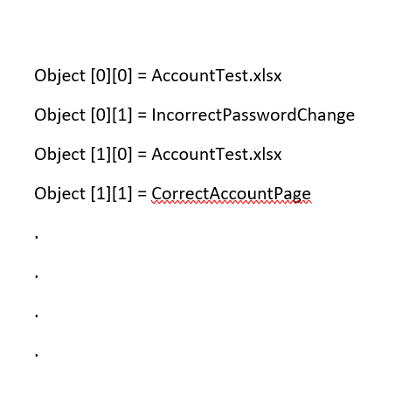
Notes:
now lets write a test
First we write a code for data provider.
Click: As u can see we have provided the path for the excel workbook and the name of the excel sheet that we want to read.
Click: now the dataprovider creates a list in memory where each cell is saved in a list as shown on the right.
The reason we have data provider is because we can reuse the code that we will be writing in test

Slide 16
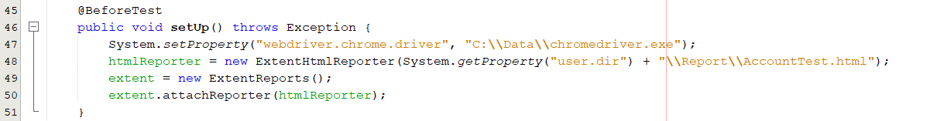
Notes:
Now we write the steps that we what to perform before the test starts
In this we will set up the webdriver then we will start creating a report that helps us know if the program is running properly

Slide 17
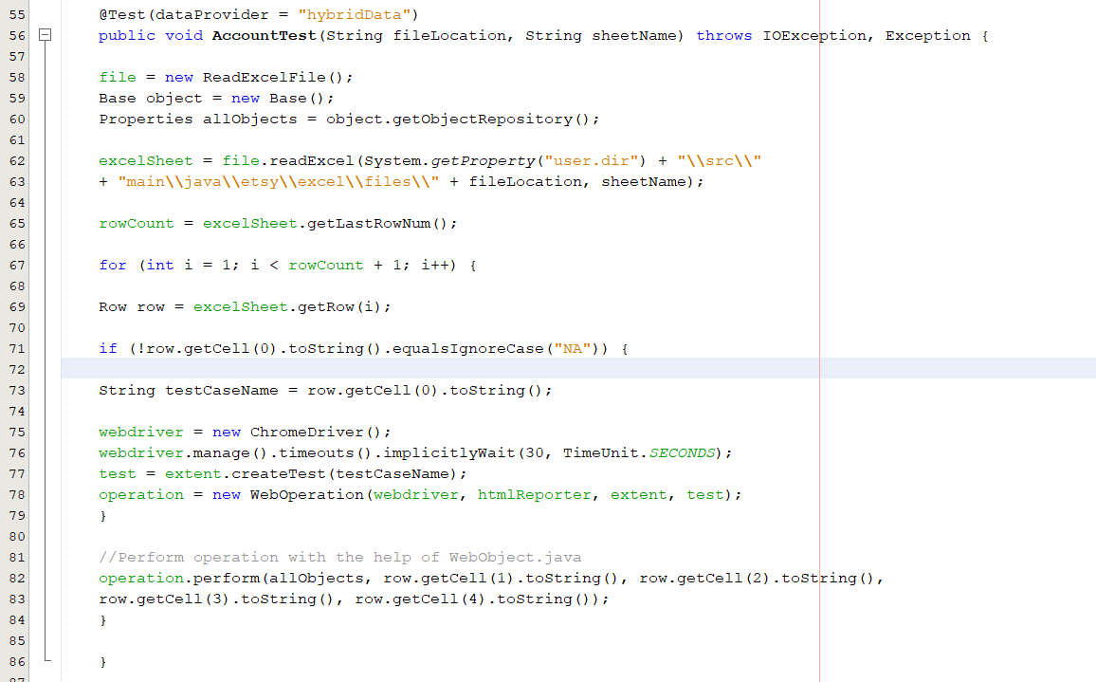
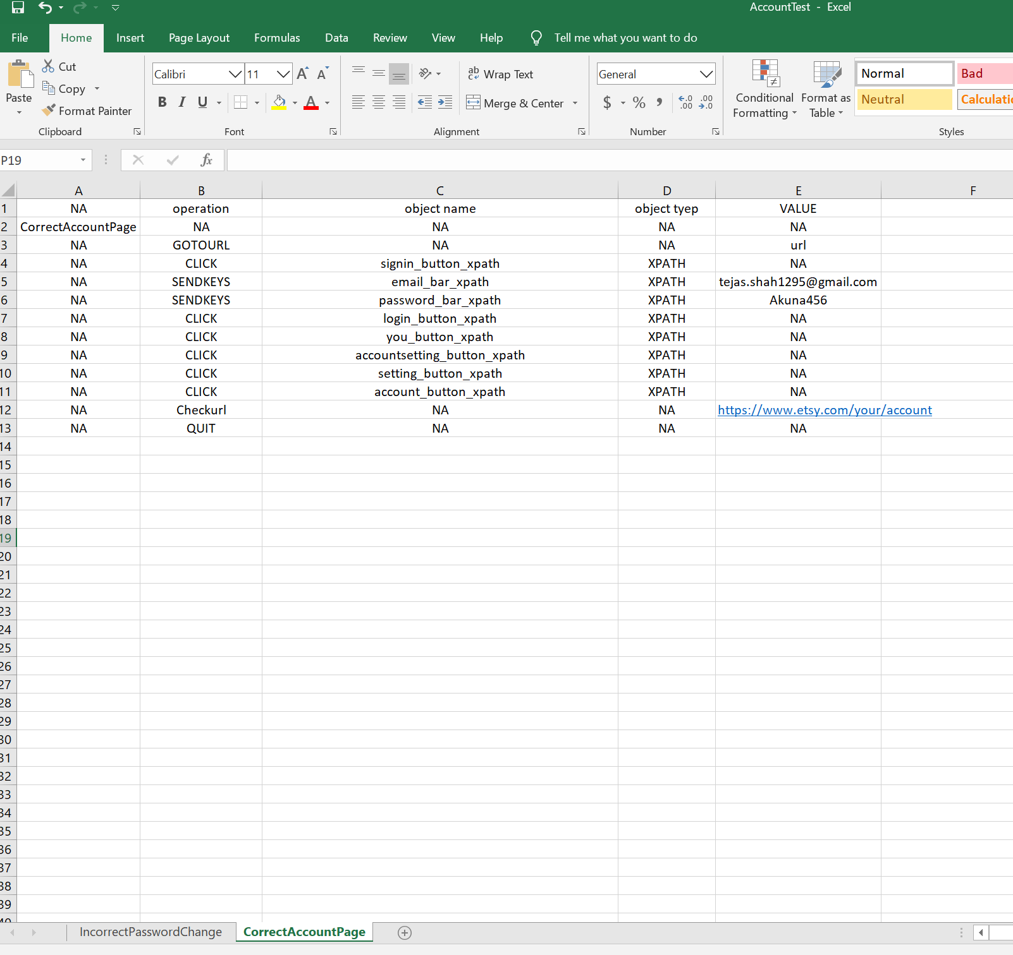
Notes:
The next step is to write the test.
in here we will first get two input from the data provider
click: 1) file Location And 2) Sheet name
Click Now with the help of read excel class we will read the test case as written in excel file
Click: for example if the data provided from the data provider is AccountTest.xlsx and CorrectAccountPage that it will read this excel file
as you can see the first column contains the test case name second column contains keywords, third column contains keyword that will be compared with the object repository to provide us with the xpath, ID, Name Etc, Fourth column contains object type and the last column contains the values that we want to pass or compare.
click:
click: now if the test name is present than it will launch a web browser
click: now property and column 2-5 are passed in this step which are send to the web operation class to perform the test.

Slide 18
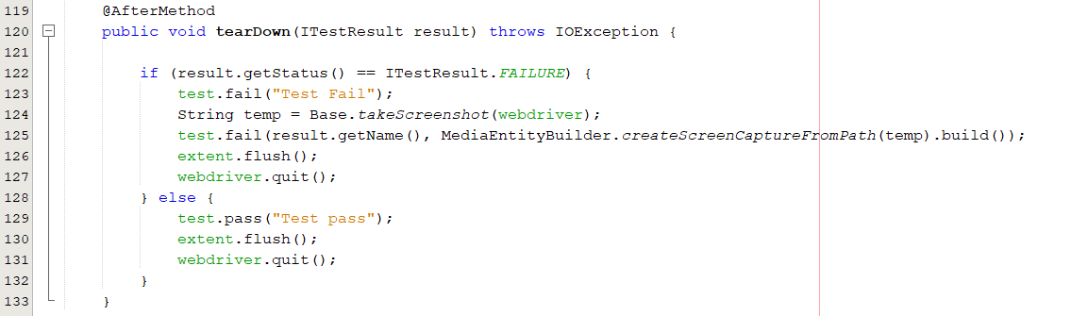
Notes:
Now we use the after method step
here we close the report and the webdriver
we also check if the test failed of passed and if the test failed we take a screenshot.

Slide 19
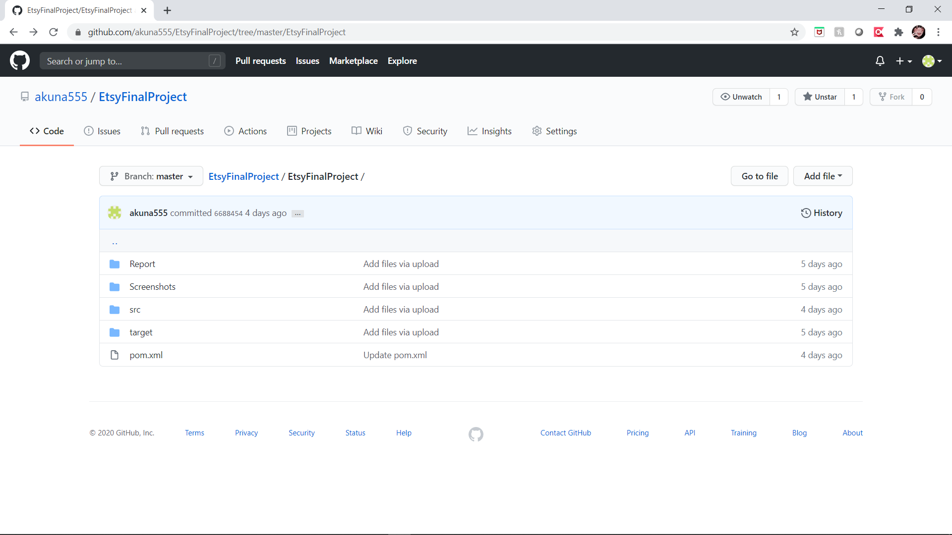
GitHub.
Notes:
1. For our project we crated repository in GitHub. It helps us coordinate work and it also help us track changes in any files. Helps team to collaborate.
2. Version control is important to keep track of changes – and keep every team member working off the latest version.

Slide 20
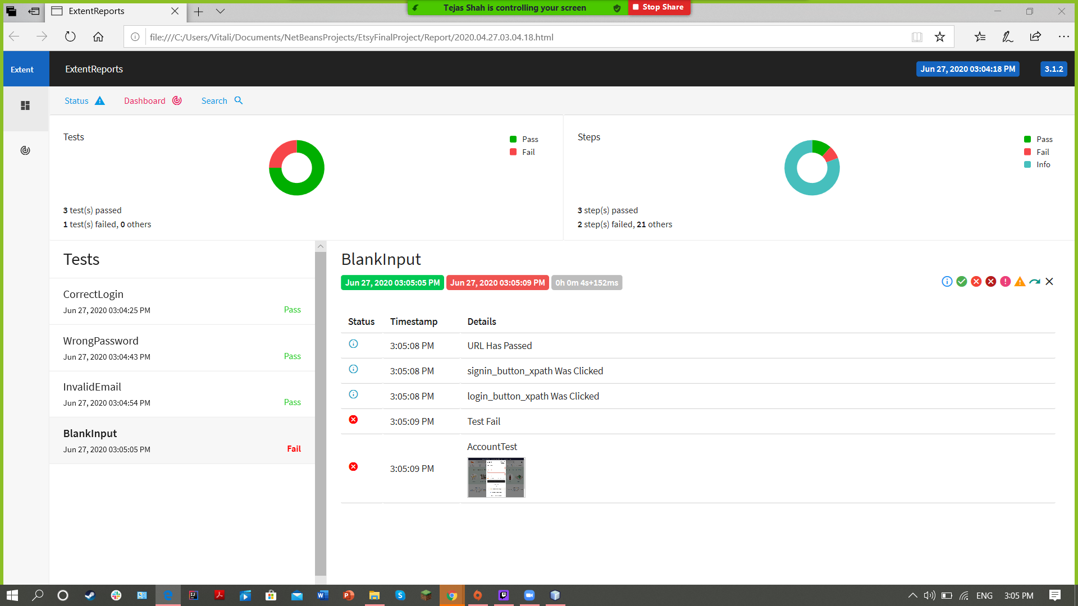
Extent Report.
Notes:
1. For our project we chose Extent Report.
2. EXTENT REPORT -> is reporting tool that generates HTML report, with detailed steps, metrics and screenshots.
3. Extent Report are the most popular reporting used with Selenium. As we all know , TestNG generates html reports by default but they are not more readable and interactive.
4. Big part of QA activities is reporting. We do share the repot to the team to show the results of the test execution. Also we need to present the report which can be easily understandable to everyone by displaying some graphs.
5. In our project we initialize Extent Report @BeforeTest .
6. ExtentHtmlReport -> we used to customize the html of the report.
7. ExtentReports – we used to set the path where report will be generated.
8. Also our Extend Report generates screenshots just when our code fails. Also ExtendReport will stop at the step where it is failed. So it is very easy to find flailed step.

Slide 21
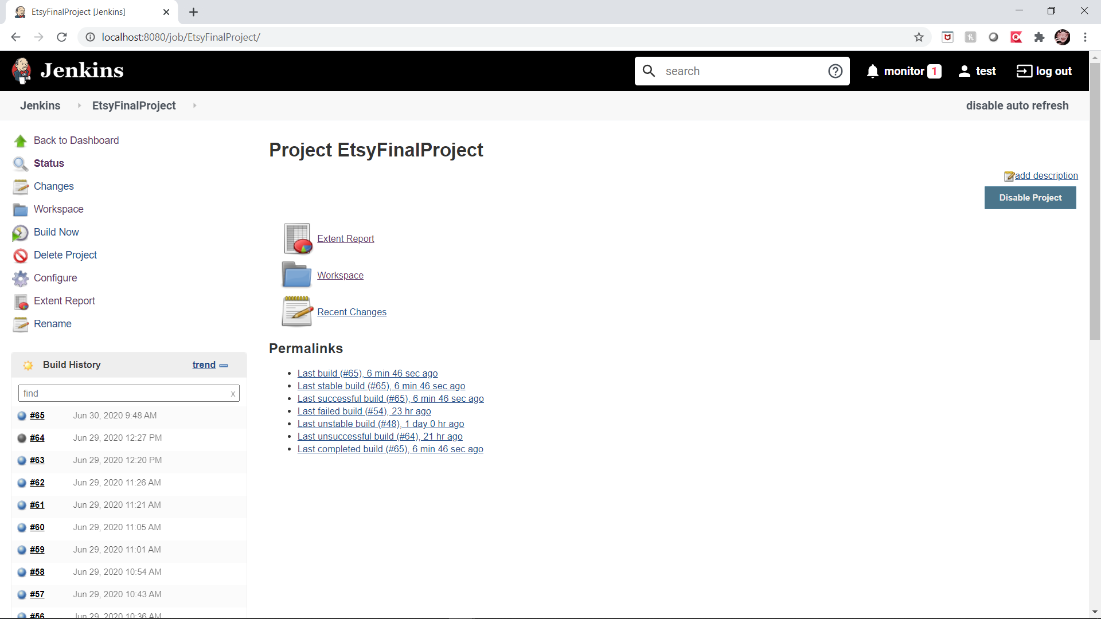
Jenkins.
Notes:
1.In our project we used Jenkins for scheduling and running out automated tests.
2.Jenkins is continuous Integration tool. It is used to schedule and automated builds, deployments and etc. So Jenkins can run any automated test. For example we can have unit, smoke tests, integration tests, regression tests and more.
3.Jenkins can test different layers of the application. Jenkins does not care if we are testing UI or Database or API. It only kicks of the tests and sends reports. So if our automated test is Ui test it means Jenkins is running UI tests.
4.How our tests are configured on Jenkins?
ØOur Jenkins job is configured to get my automated test from GitHub and run every day using Maven.
ØIn configuration, first I created new job and gave name EtsyFinalProject.
ØThen I selected option git in the Source Code Management section and entered the path to my framework on GitHub. And entered the git credentials.
ØNext configuration is about build triggers where I chose option Build periodically. And enter the time how often I want to run tests.
ØIn the Build section, I choose option invoke top level Maven command. Since our automation framework is created using maven.
ØI add HTML publisher plugin reports option. This plugin will generate html report for every build. And all reports for all builds are saved.
ØI add email option as the next Post-build Actions. We also can configure it so that everyone in my Agile team is notified about the test results.
Ø
Ø
Ø
●
●

Slide 22
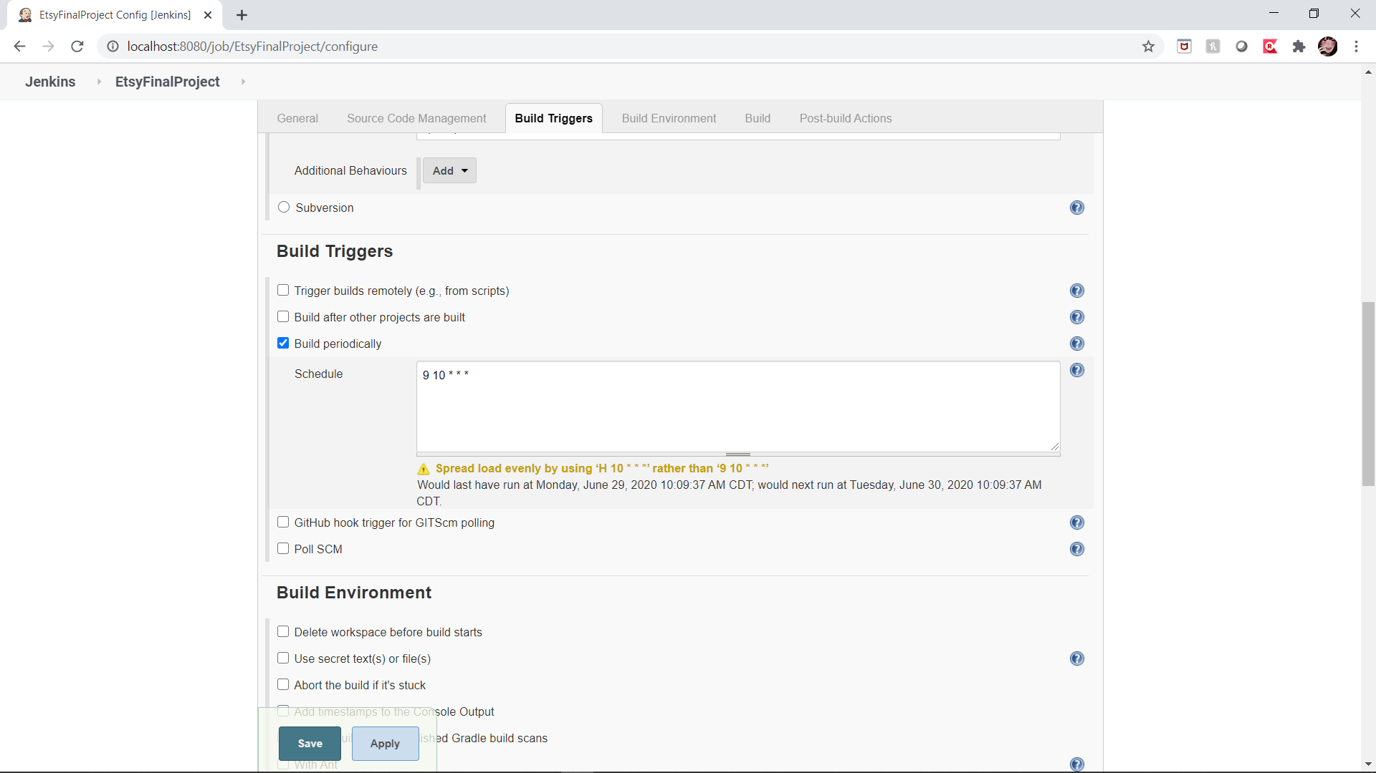
Build schedule.
Notes:
4.How our tests are configured on Jenkins?
ØOur Jenkins job is configured to get my automated test from GitHub and run every day using Maven.
ØIn configuration, first I created new job and gave name EtsyFinalProject.
ØThen I selected option git in the Source Code Management section and entered the path to my framework on GitHub. And entered the git credentials.
ØNext configuration is about build triggers where I chose option Build periodically. And enter the time how often I want to run tests.
ØIn the Build section, I choose option invoke top level Maven command. Since our automation framework is created using maven.
ØI add HTML publisher plugin reports option. This plugin will generate html report for every build. And all reports for all builds are saved.
ØI add email option as the next Post-build Actions. We also can configure it so that everyone in my Agile team is notified about the test results.

Slide 23
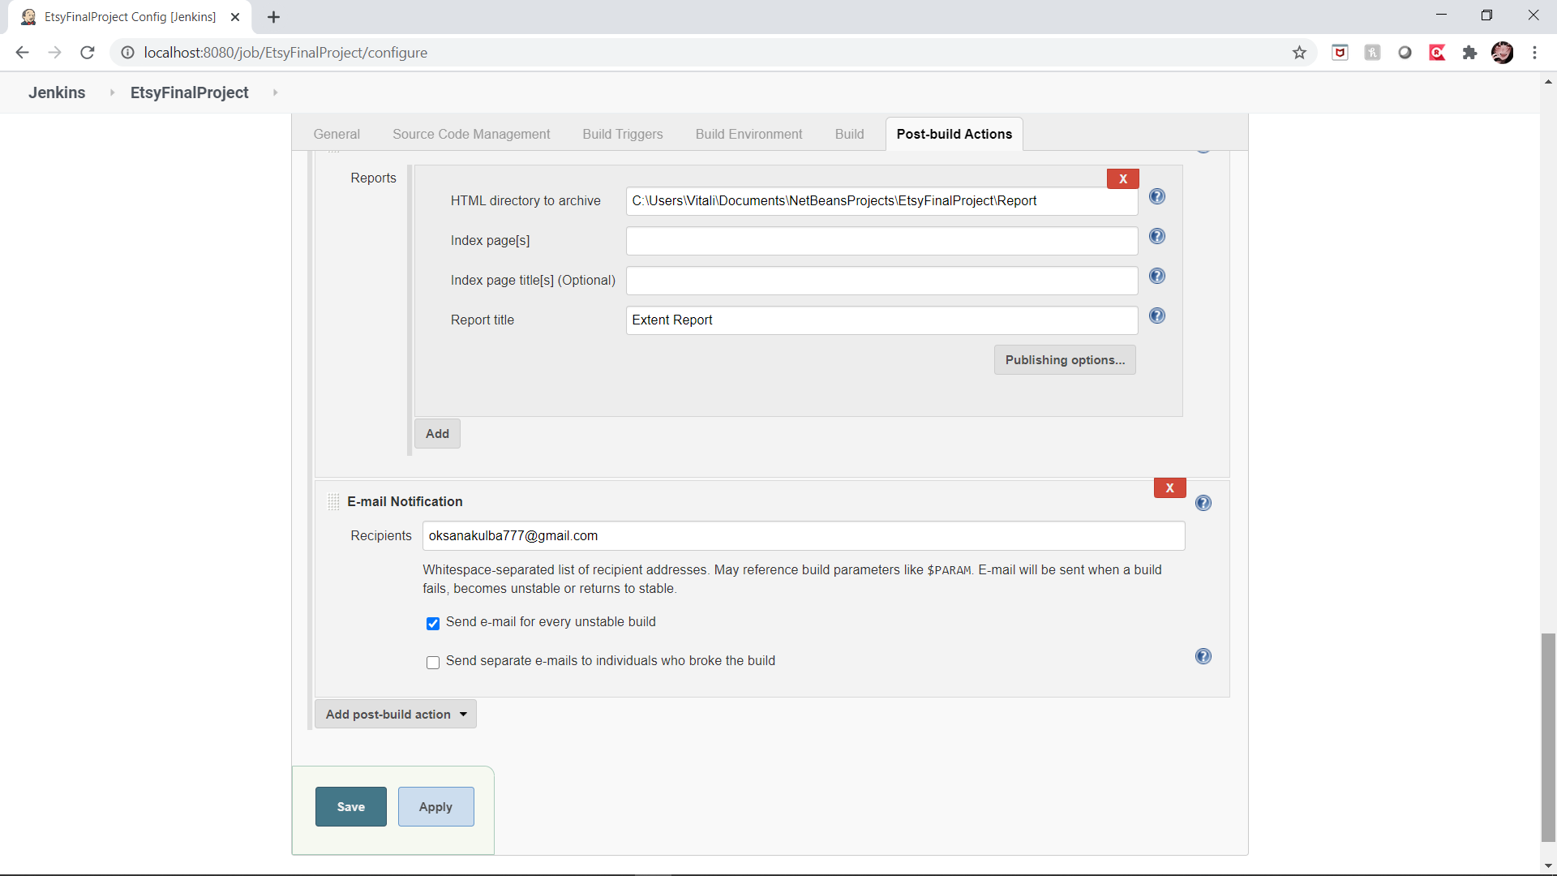
E-mail Notification.
Notes:
4.How our tests are configured on Jenkins?
ØOur Jenkins job is configured to get my automated test from GitHub and run every day using Maven.
ØIn configuration, first I created new job and gave name EtsyFinalProject.
ØThen I selected option git in the Source Code Management section and entered the path to my framework on GitHub. And entered the git credentials.
ØNext configuration is about build triggers where I chose option Build periodically. And enter the time how often I want to run tests.
ØIn the Build section, I choose option invoke top level Maven command. Since our automation framework is created using maven.
ØI add HTML publisher plugin reports option. This plugin will generate html report for every build. And all reports for all builds are saved.
ØI add email option as the next Post-build Actions. We also can configure it so that everyone in my Agile team is notified about the test results.

Slide 24
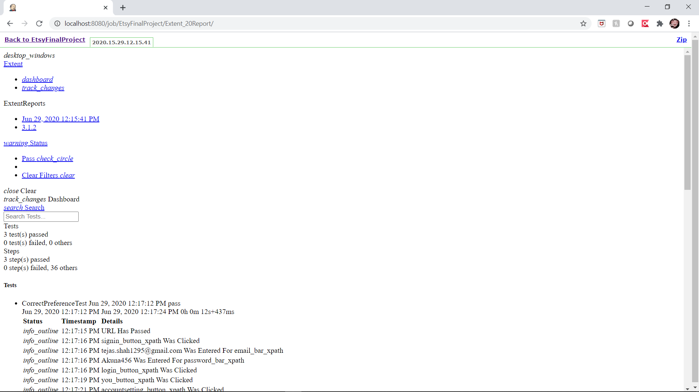
Test Report.

